Slide 1

Virtual Private Network
Connectivity is achieved on a shared infrastructure, allowing for the enforcement of policies similar to those in a private network.

Slide 2
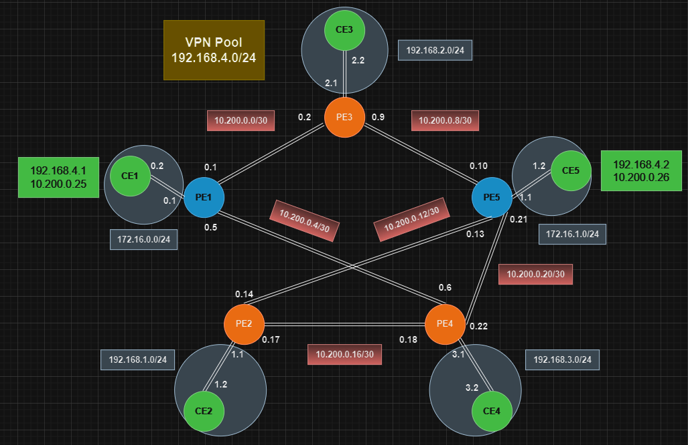
Network topology configuration

Slide 3
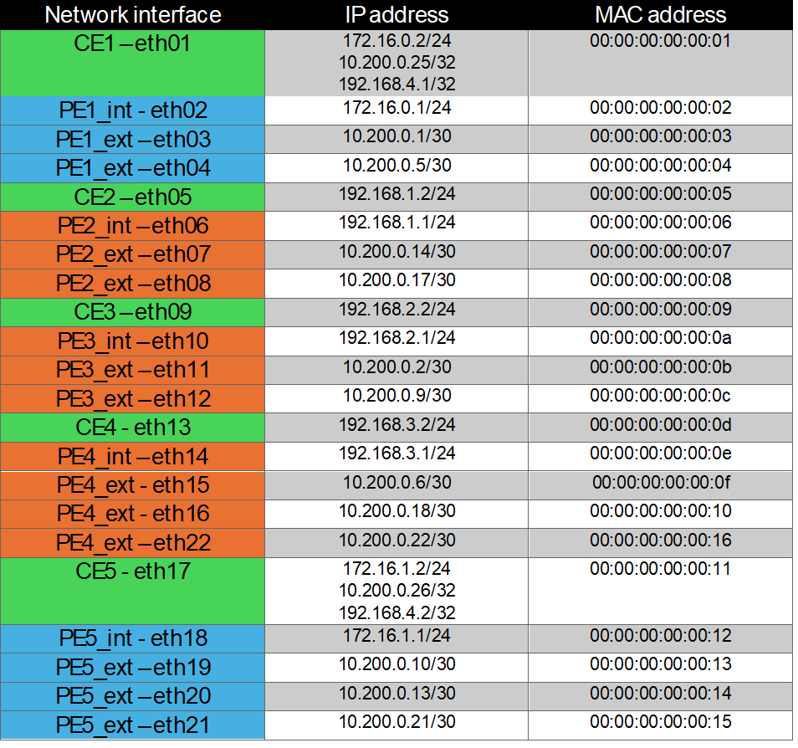
Configuration of the network interfaces

Slide 4
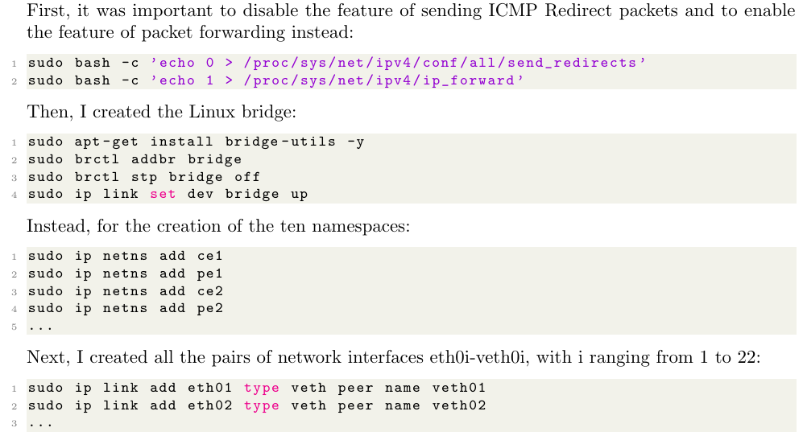
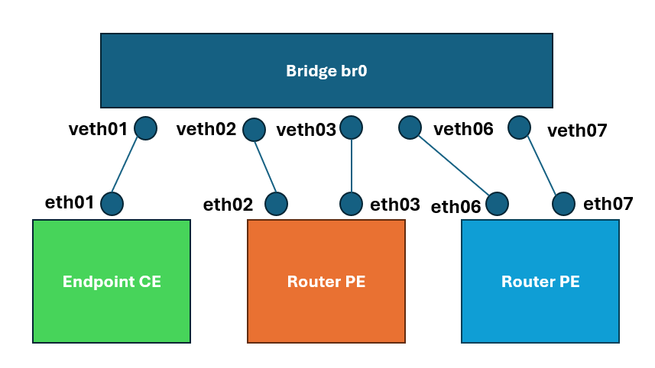
Linux namespaces
1) Disable ICMP Redirect and Enable Packet Forwarding
2) Create the Linux Bridge
3) Create the Network namespaces
4) Create all the pairs of network interfaces

Slide 5
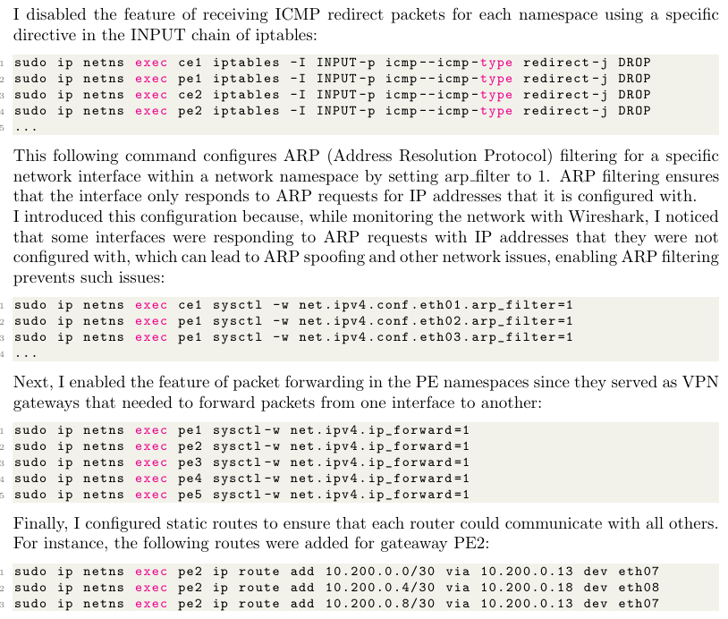
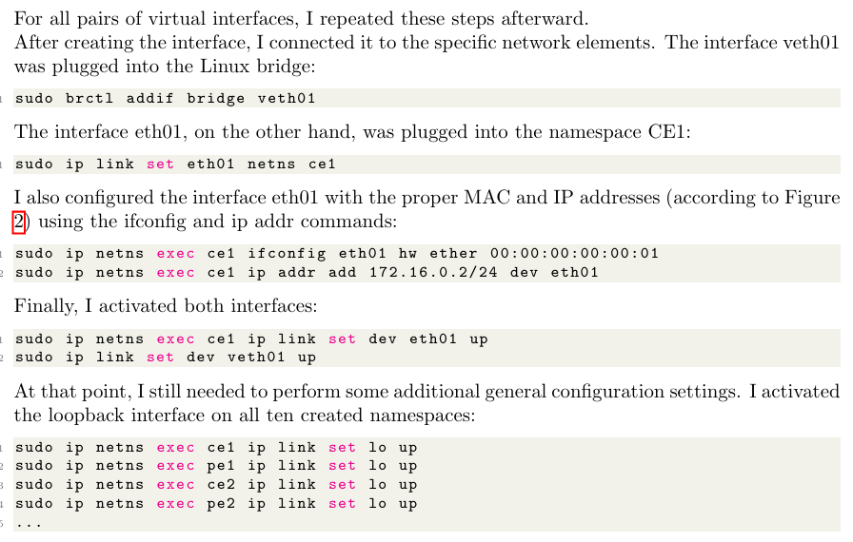
Linux namespaces
10) Disable the feature of receiving ICMP redirect
5) Connect veth to Linux Bridge
11) Enable ARP Filtering
6) Connect eth to namespace
7) Configure the interface eth MAC and IP address
8) Activate both interfaces
12) Enable Packet Forwarding in the PE namespaces
9) Activate loopback interface in each namespace
13) Static routing to allow GWs communications

Slide 6
IPSec
Internet Protocol Security
Security services
Modes: Tunnel and Transport
Authentication Header (AH)
Encapsulating Security Payload (ESP)
Security Policy (SP)
Security Association (SA)

Slide 7
ip xfrm
Transform configuration
State
Policy

Slide 8
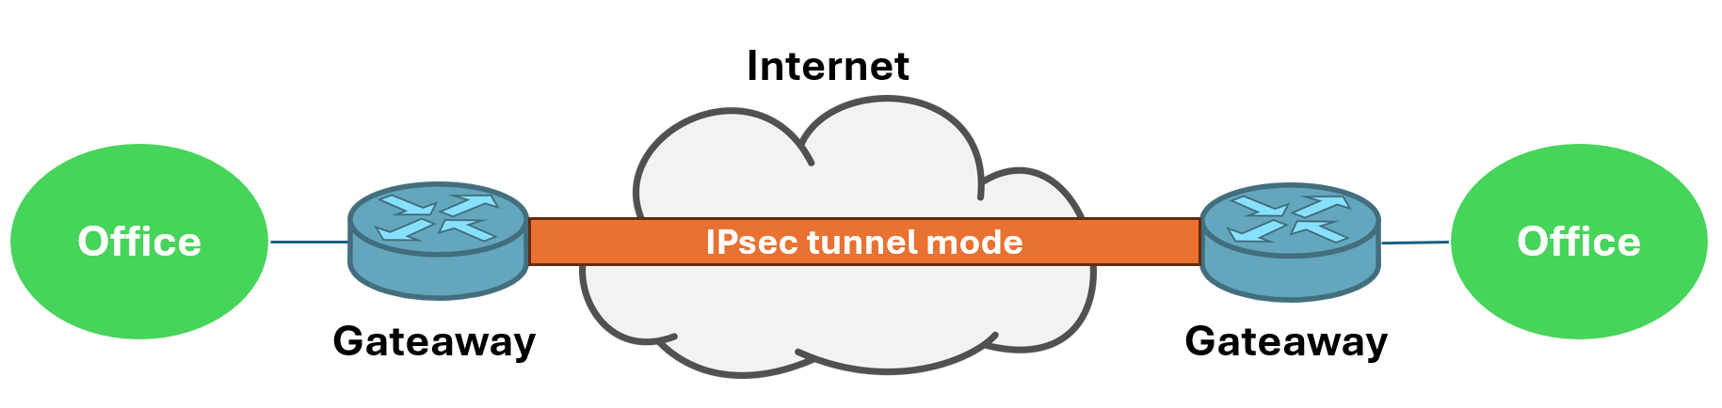
Site-to-site VPN

Slide 9
Site-to-site VPN
Simplified Administration
Scalability
Seamless Connectivity
Lack of Endpoint Authentication
No End-to-End Security Against Internal Network Attacks
Internal Traffic Analysis
Single Point of Failure

Slide 10
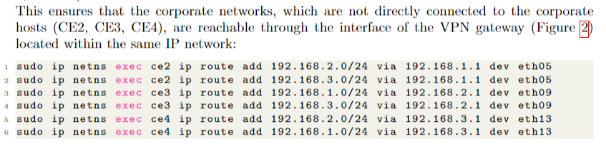
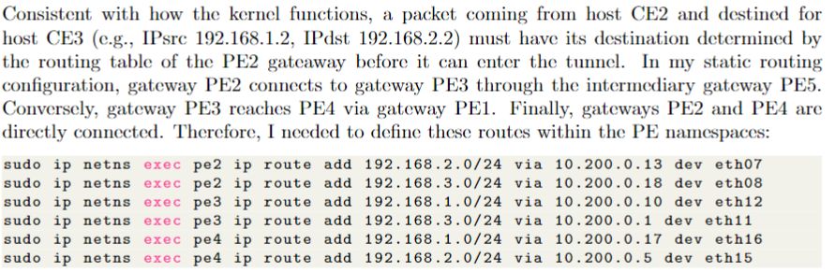
Step-by-Step Configuration
1) Ensure that corporate networks not directly connected are reachable through the VPN gateaway
2) Routing within the gateaway namespaces, essential due to the sequence of events for routing and applying IPsec policies in
the Linux kernel

Slide 11
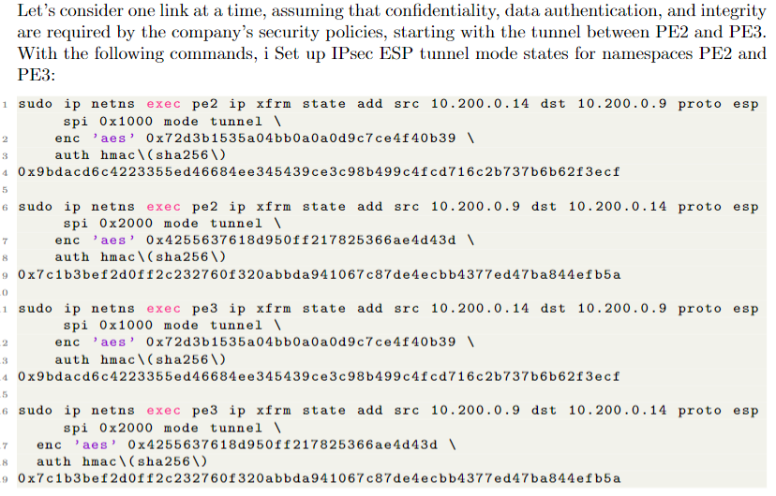
Step-by-Step Configuration
3) Set up IPsec ESP tunnel mode states for namespaces PE2 and PE3

Slide 12
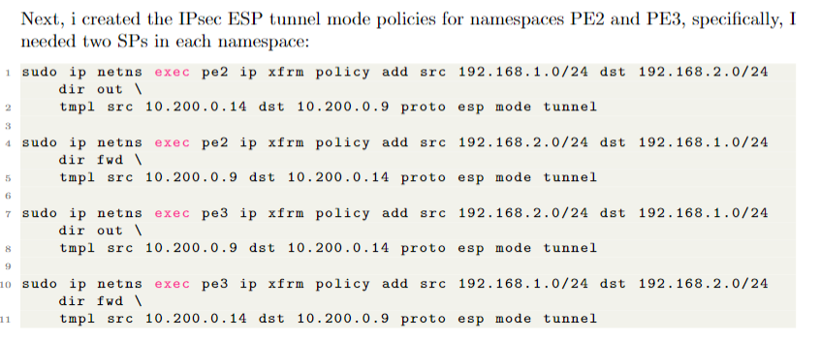
Step-by-Step Configuration
4) Set up IPsec ESP tunnel mode policies for namespaces PE2 and PE3

Slide 13
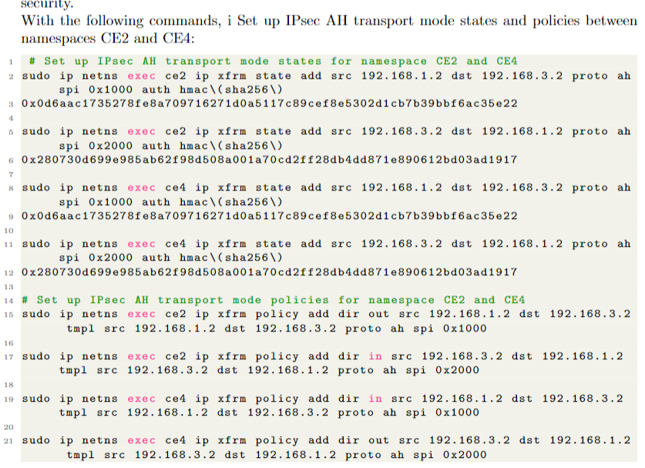
5) Set up IPsec AH tunnel mode states and policies for namespaces CE2 and CE4

Slide 14
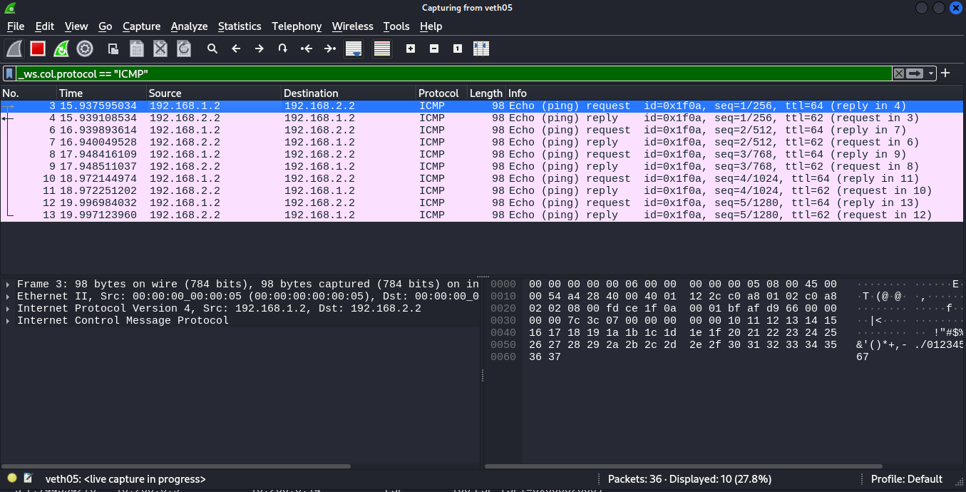
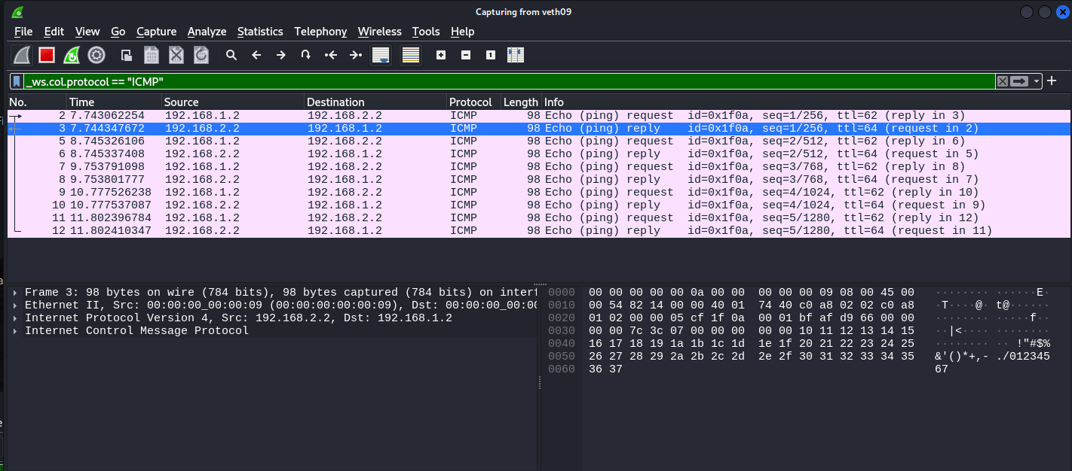
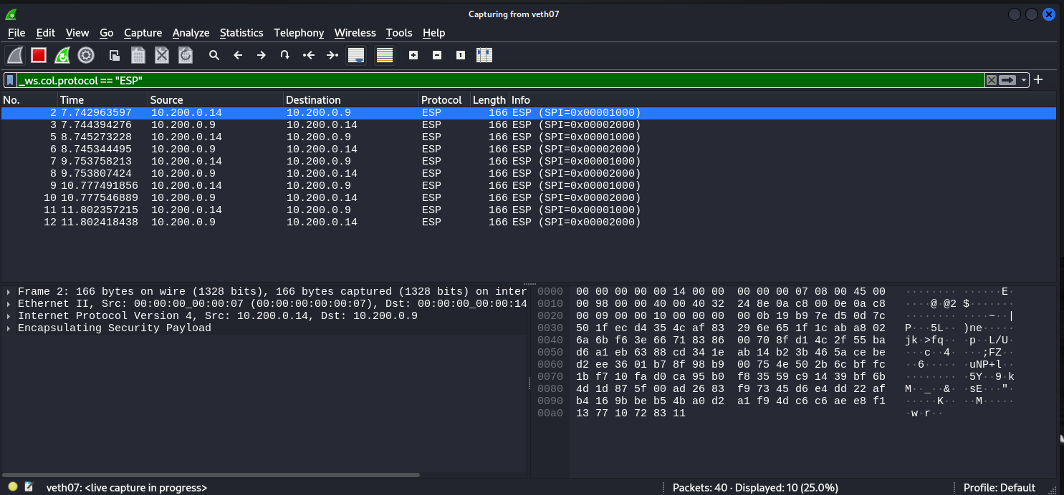
eth05
eth09
eth07

Slide 15
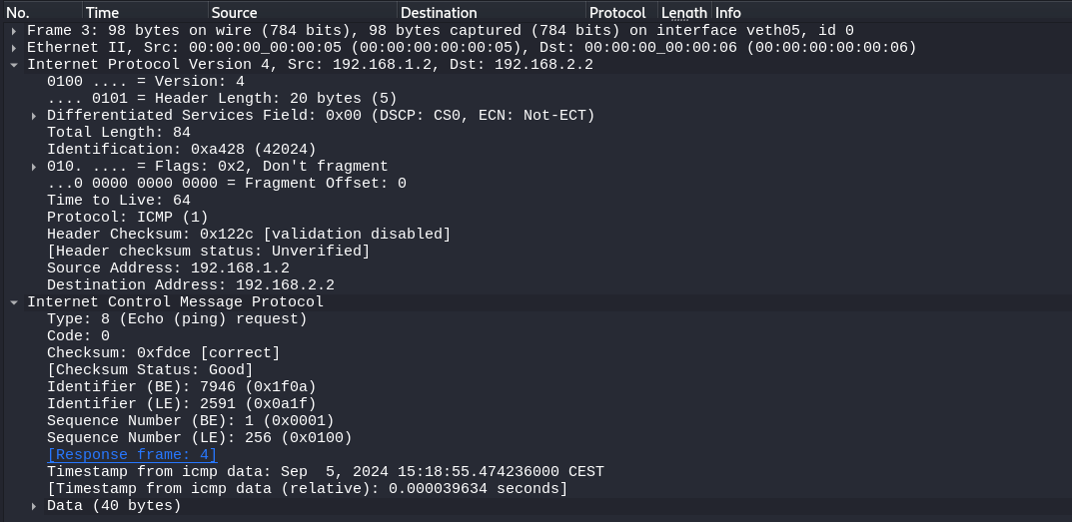
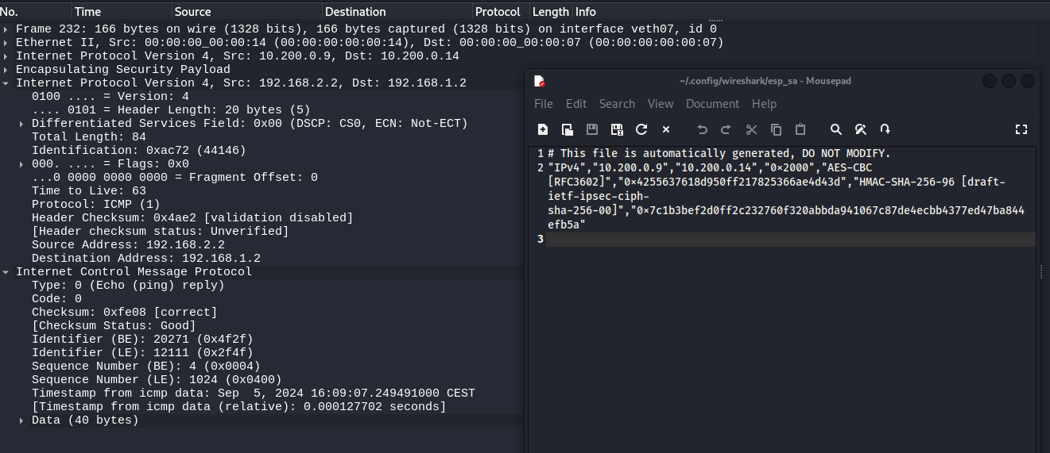
eth05
eth07

Slide 16
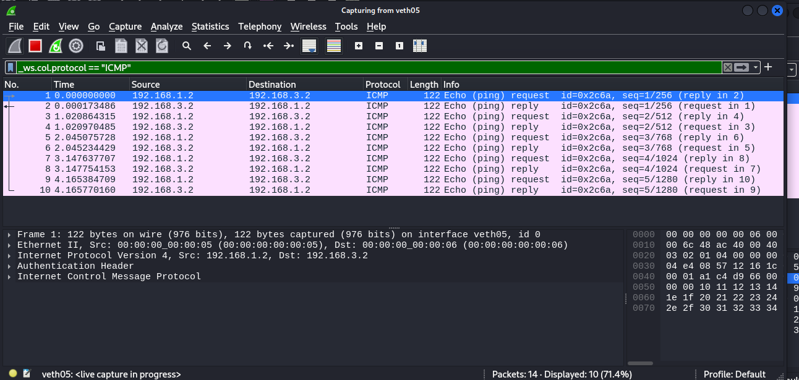
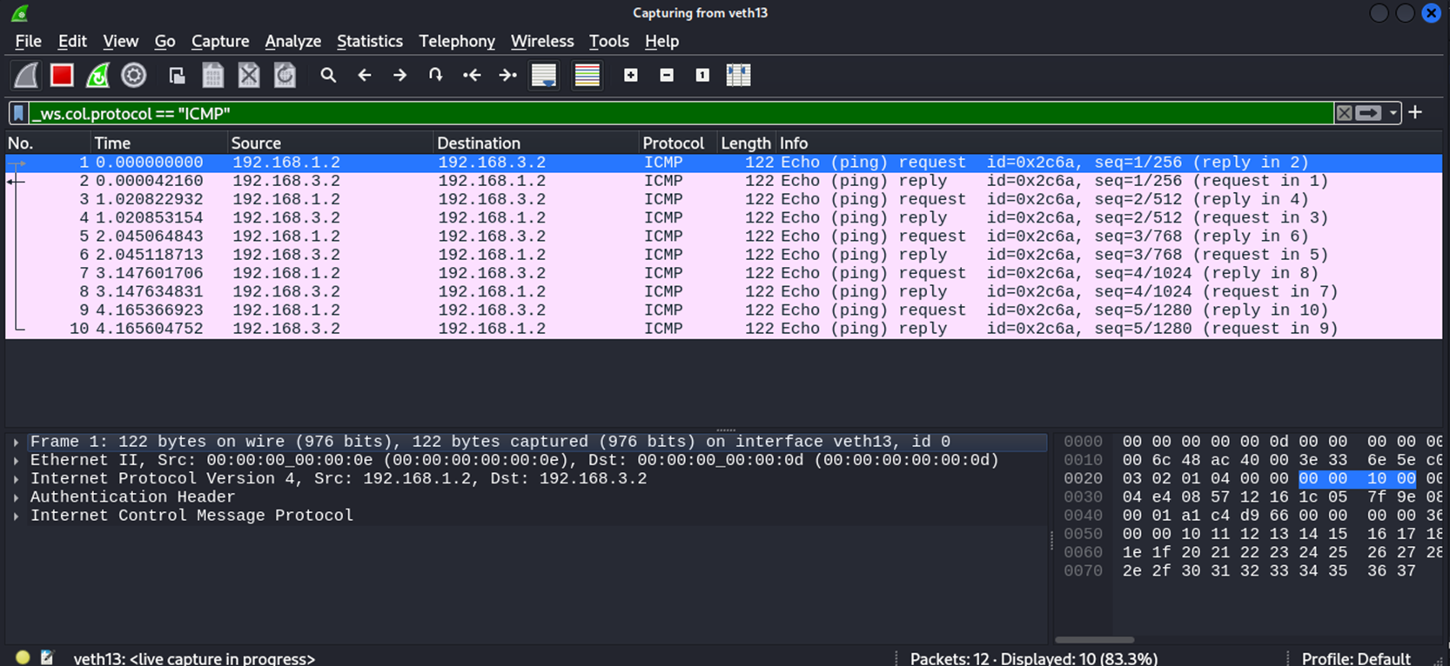
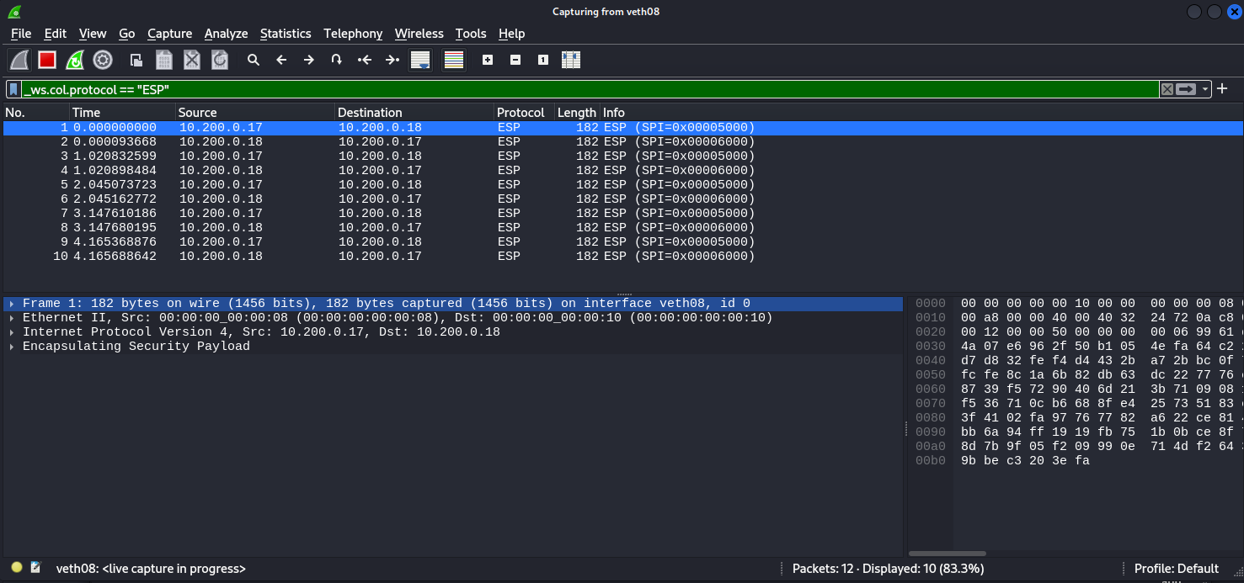
eth05
eth13
eth08

Slide 17
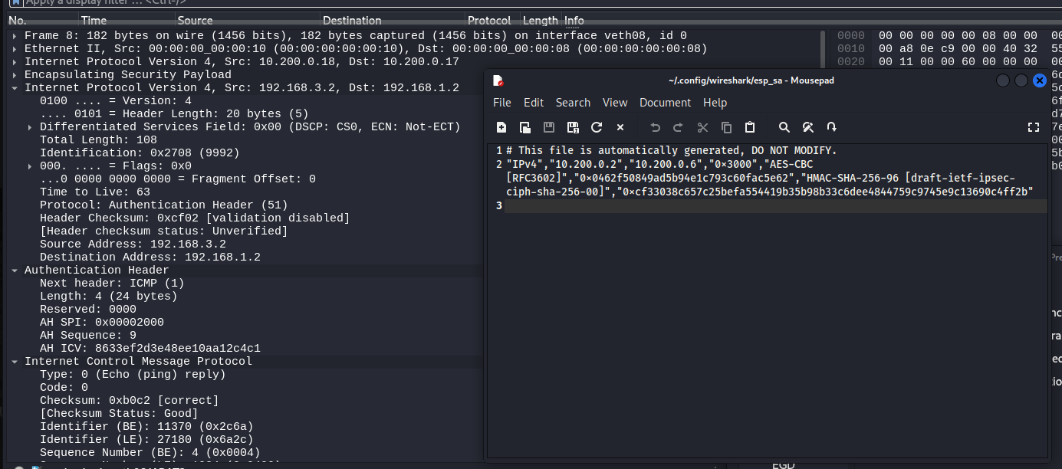
eth08

Slide 18
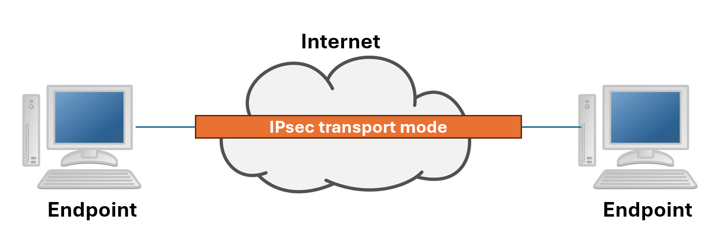
End-to-End VPN

Slide 19
End-to-End VPN
Endpoint Authentication
Protection Against Untrusted Networks
Potential Compatibility Issues
Configuration Complexity

Slide 20
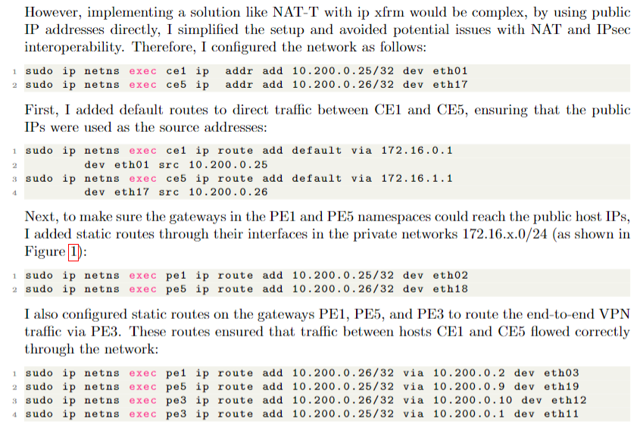
Step-by-Step Configuration
1) Assign public IP addresses within namespaces CE1 and CE5
2) Add default routes ensuring that the public IPs are used
3) Make the public host IPs reachable by the gateaways PE1 and PE5
4) Add static routes on the GWs to route the end-to-end VPN traffic via PE3

Slide 21
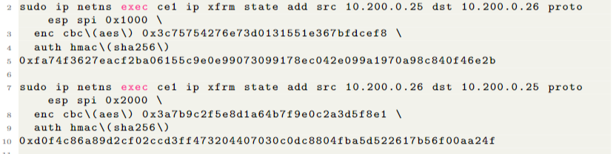
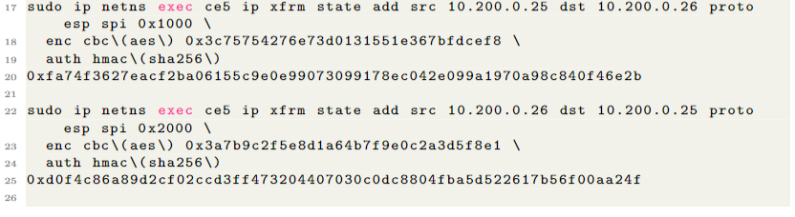
Step-by-Step Configuration
5) Set up IPsec ESP transport mode states for namespaces CE1 and CE5

Slide 22
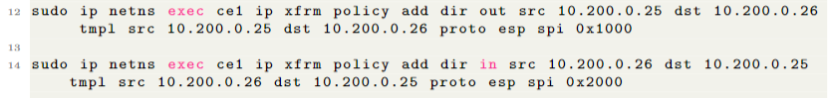
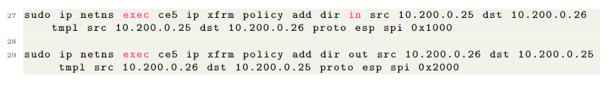
Step-by-Step Configuration
6) Set up IPsec ESP transport mode policies for namespaces CE1 and CE5

Slide 23
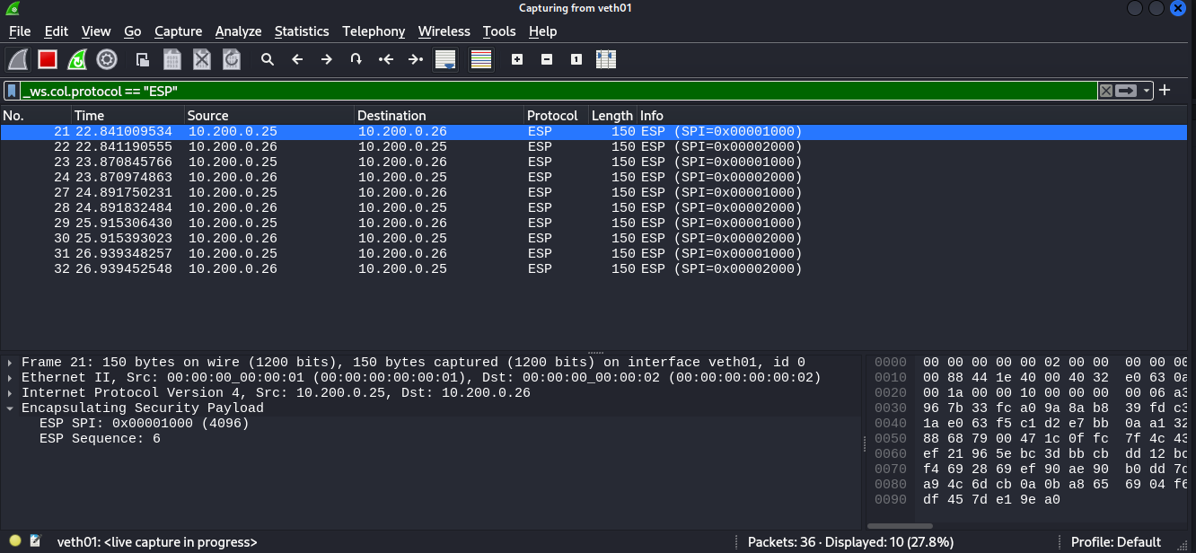
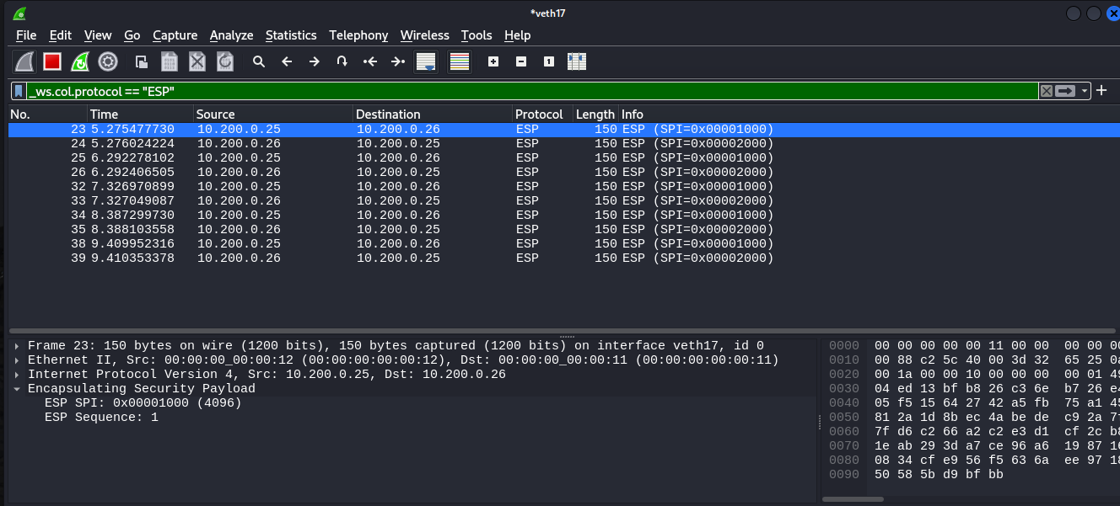
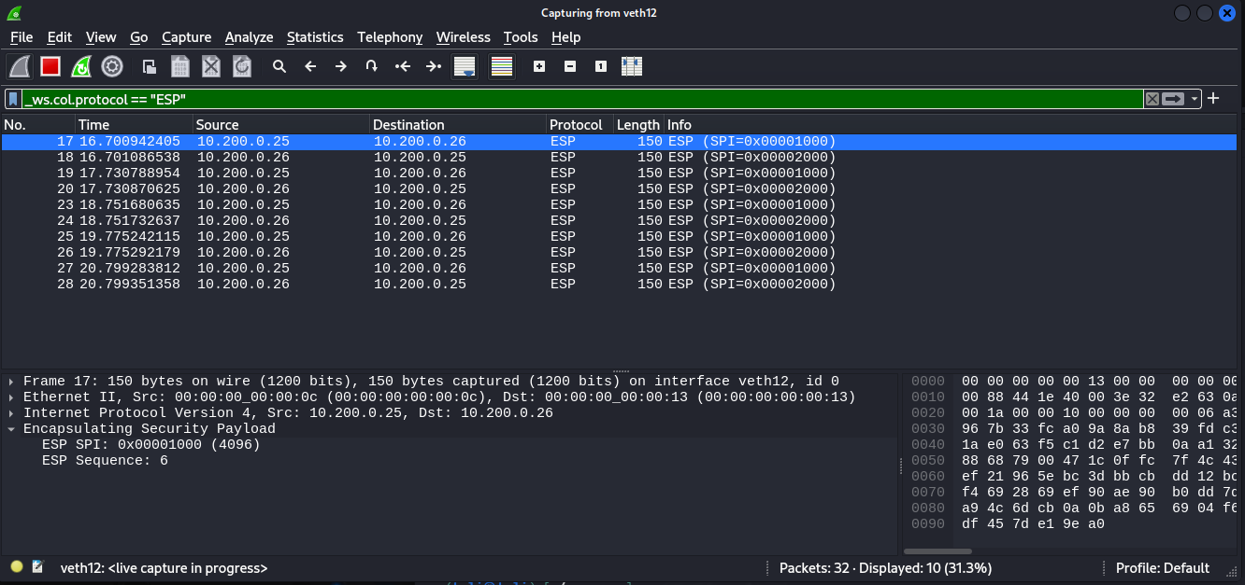
eth01
eth17
eth12

Slide 24
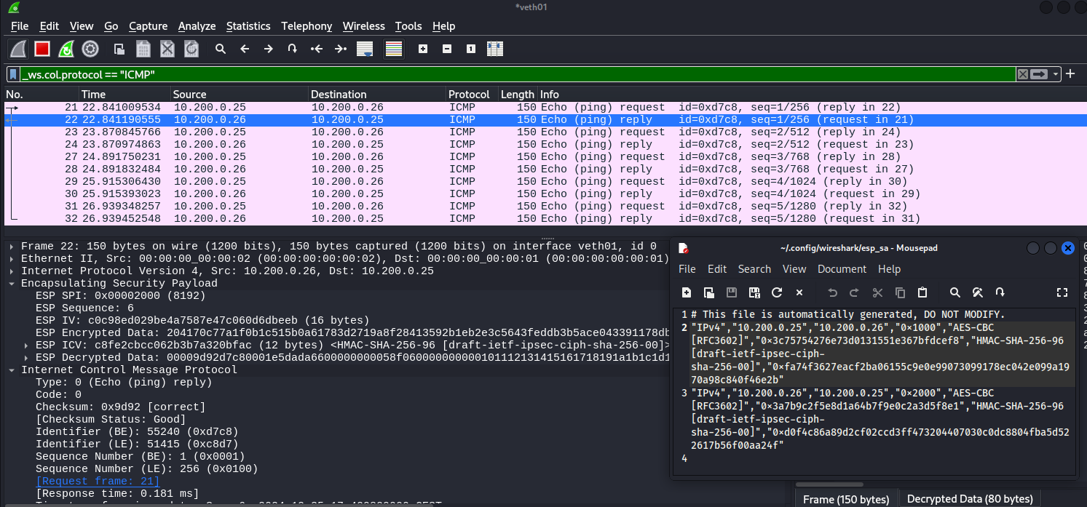
eth01

Slide 25
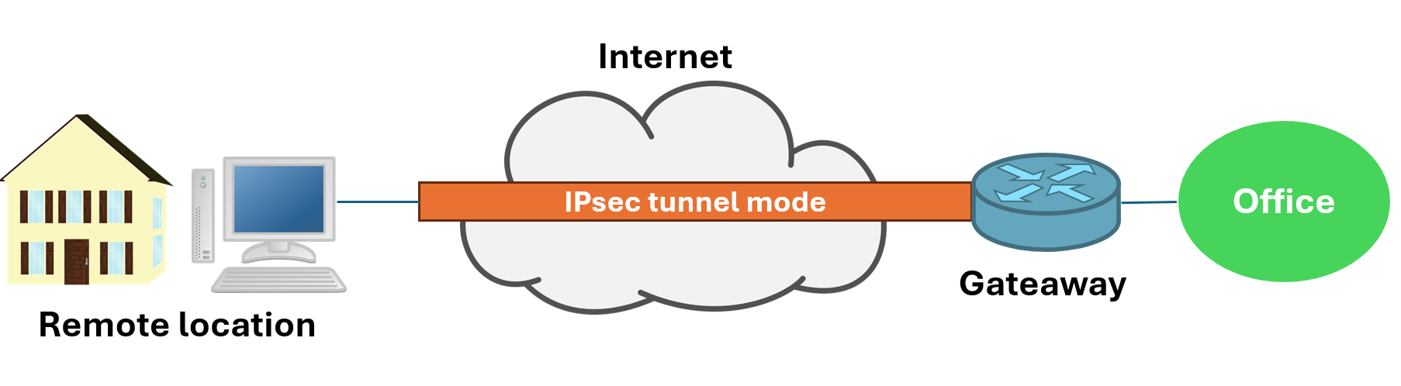
Remote Access VPN

Slide 26
Remote Access VPN
User authentication
Simplified Management
Cost-Effectiveness
Inconsistent User Experience
Endpoint security
Performance Issues
Internal traffic analysis

Slide 27
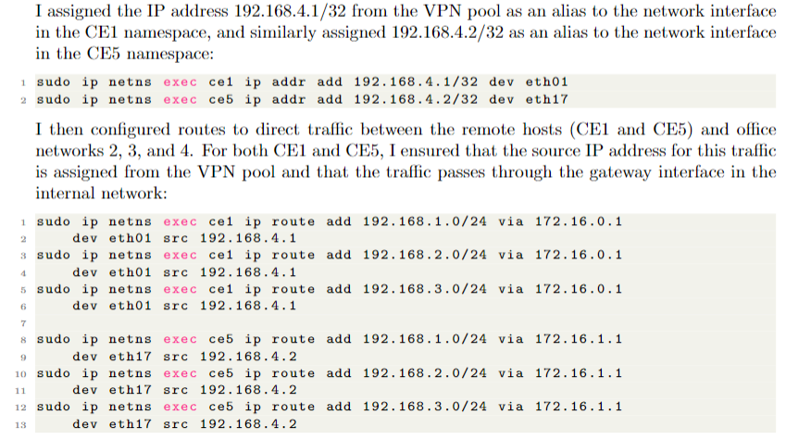
Step-by-Step Configuration
1) Assign IP address from VPN pool in CE1 and CE5 namespaces
2) Configure routes to direct traffic between remote hosts and office networks, ensuring that the source IP address is the one previously assigned from the VPN pool

Slide 28
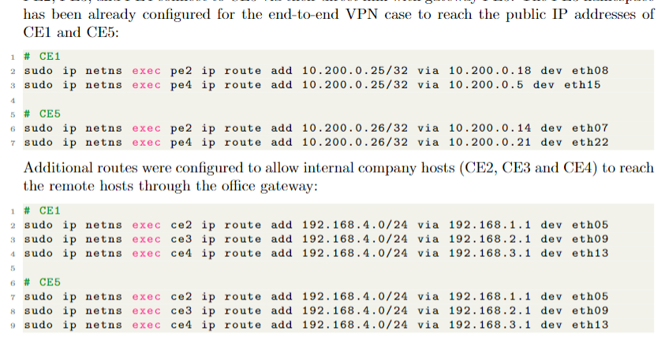
Step-by-Step Configuration
3) Static routes on the company gateaways to enable communications with the public IP addresses previously assigned in CE1 and CE5 namespaces
4) Routes to allow company hosts CE2, CE3 and CE4 to reach remote hosts through the office gateaway

Slide 29
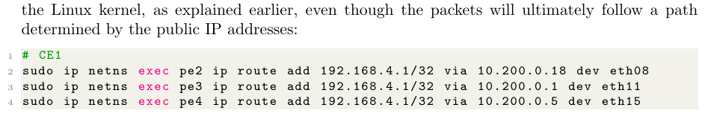
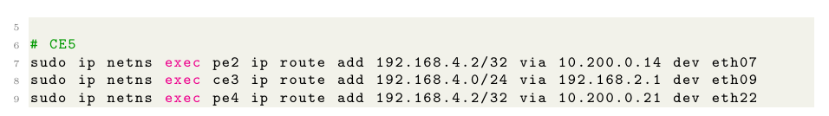
Step-by-Step Configuration
5) Routes for the private addresses of the remote hosts on the gateways, consistent with how Linux Kernel functions

Slide 30
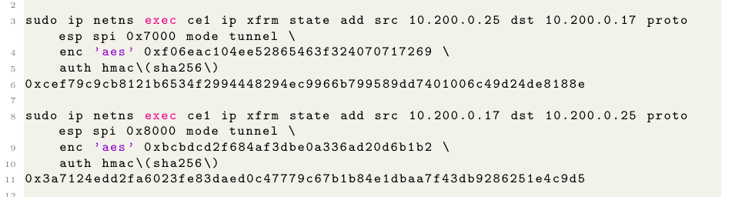
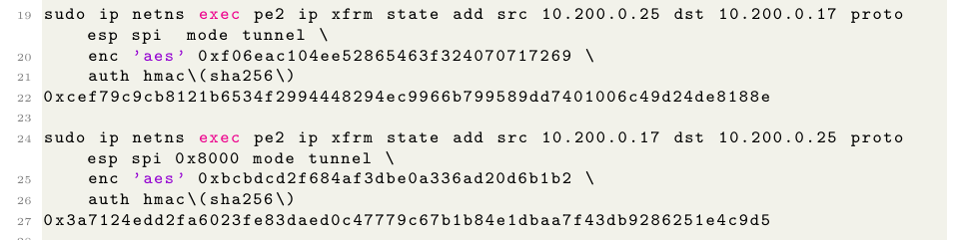
Step-by-Step Configuration
6) Set up IPsec ESP tunnel mode states for namespaces CE1 and PE2

Slide 31
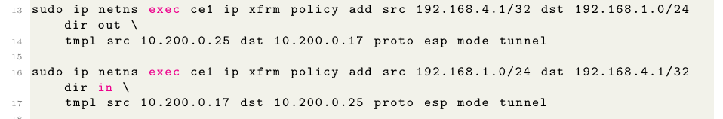
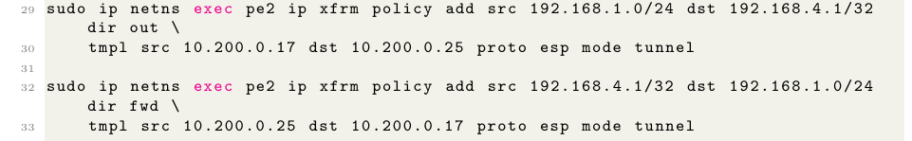
Step-by-Step Configuration
7) Set up IPsec ESP tunnel mode policies for namespaces CE1 and PE2

Slide 32
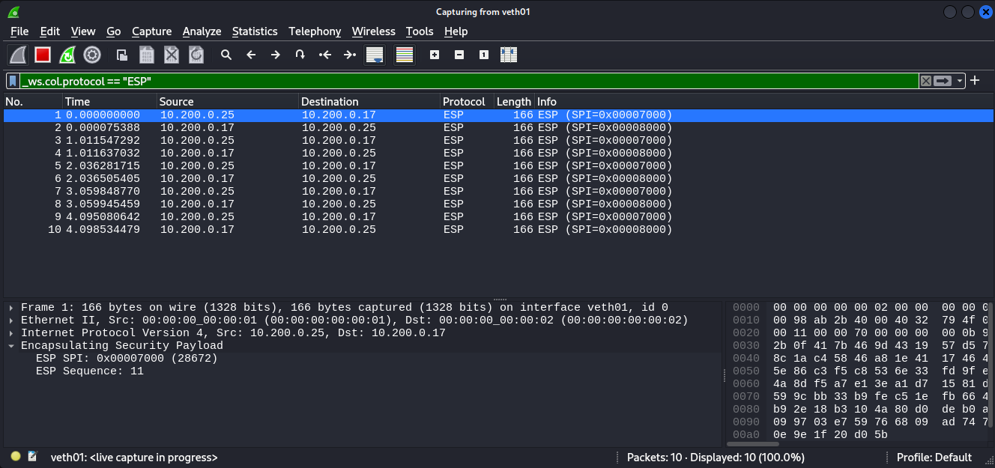
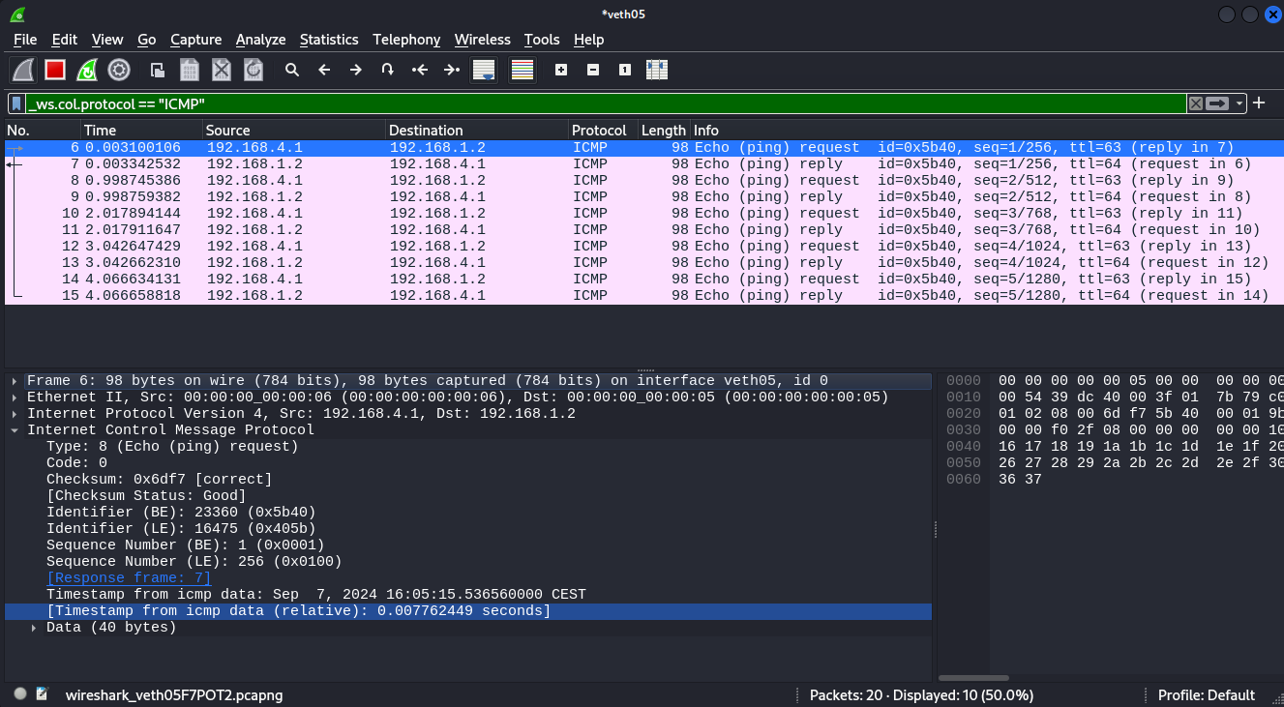
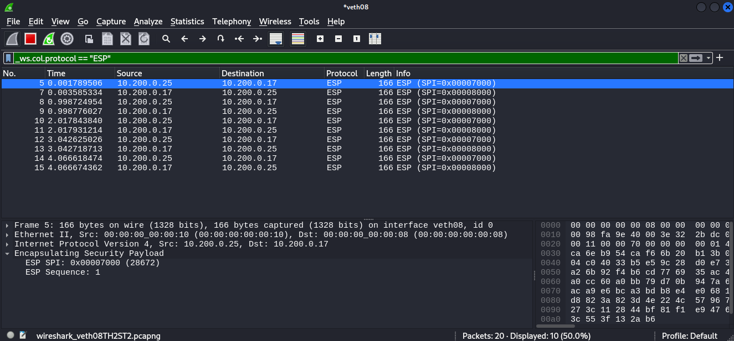
eth01
eth05
eth08

Slide 33
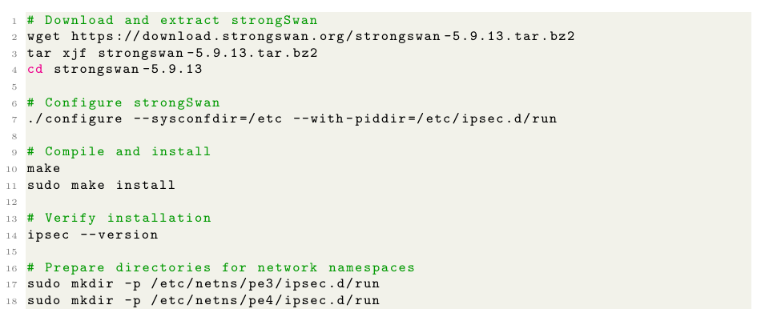
strongSwan

Slide 34
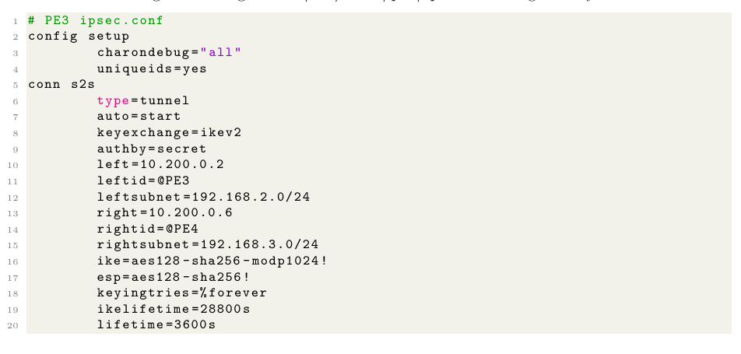
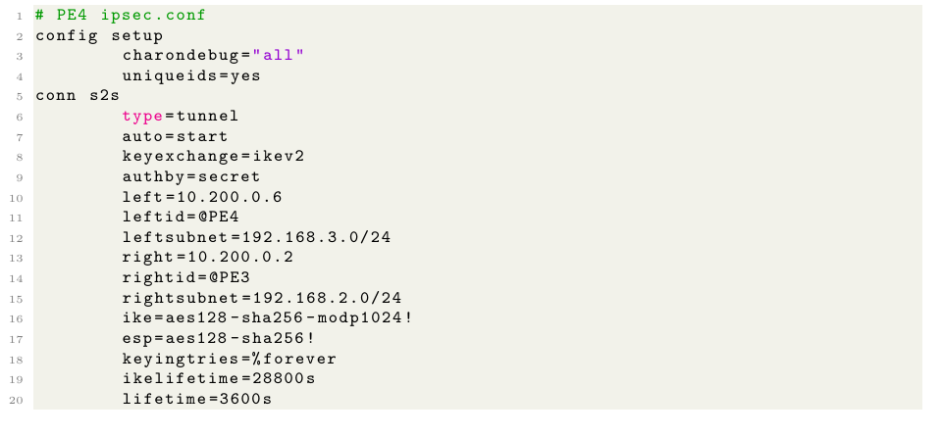
Site-to-Site VPN with strongSwan
1) Configure /etc/netns/<namespace>/ipsec.conf for gateaways PE3 and PE4

Slide 35
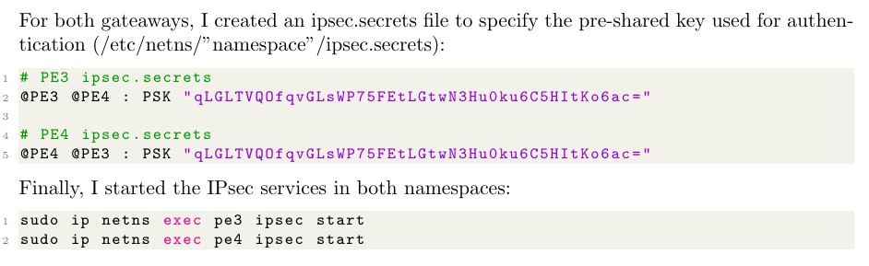
Site-to-Site VPN with strongSwan
2) Configure /etc/netns/<namespace>/ipsec.secrets for gateaways PE3 and PE4
3) Start IPsec services in both namespaces

Slide 36
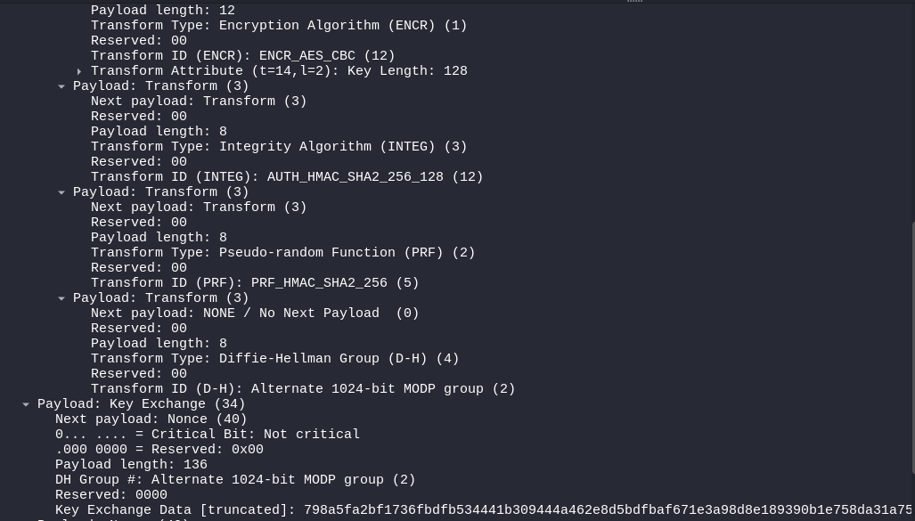
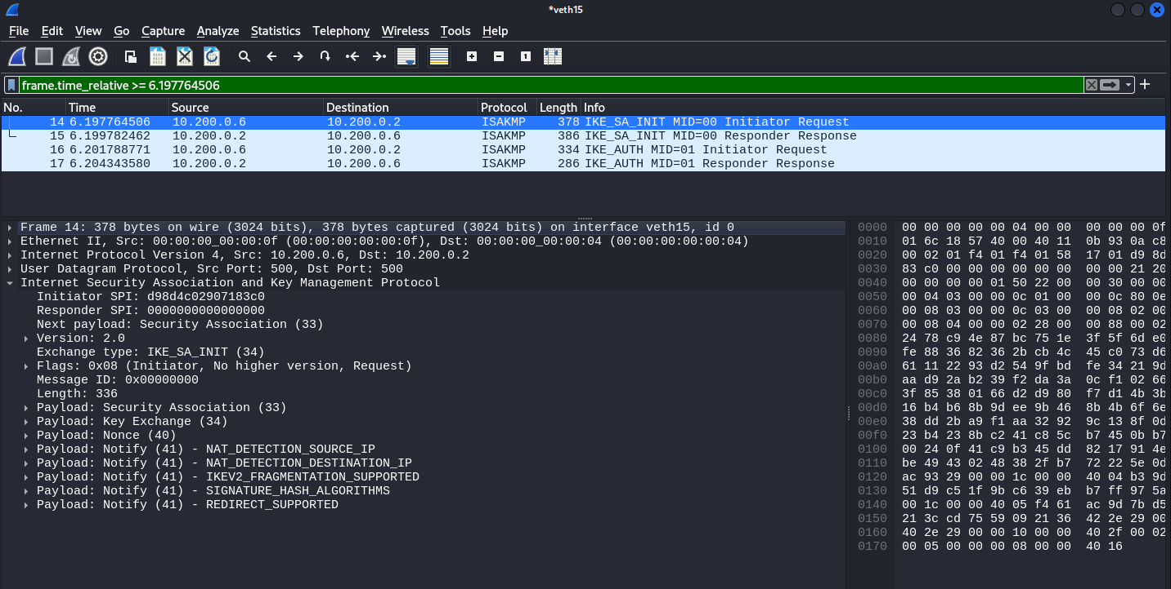
eth15
IKE_SA_INIT

Slide 37
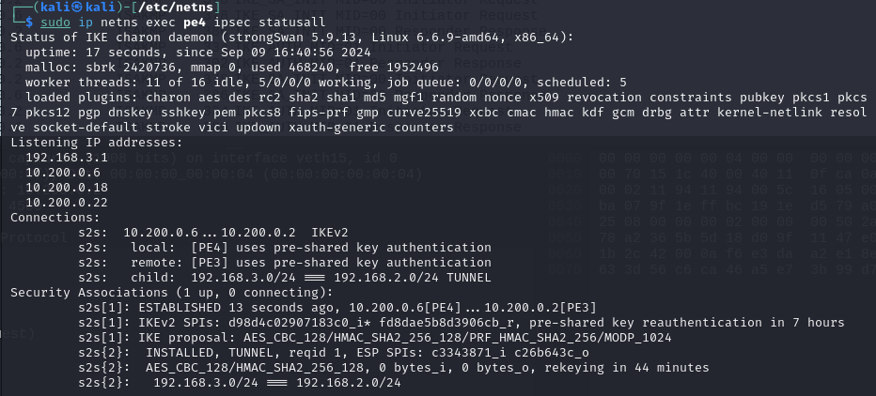

PE4
IKE_AUTH

Slide 38


eth11
PE4

